Slide 1
Systems of Linear Equations and Matrices
Algebra 2
Chapter 1

Slide 2
This Slideshow was developed to accompany the textbook
Big Ideas Algebra 2
By Larson, R., Boswell
2022 K12 (National Geographic/Cengage)
Some examples and diagrams are taken from the textbook.
Slides created by
Richard Wright, Andrews Academy
rwright@andrews.edu

Slide 3
1-01 Solve Linear Systems of Equations and Inequalities by Graphing
Objectives:
Solve a system of equations by graphing.
Solve a system of inequalities by graphing.

Slide 4
1-01 Solve Linear Systems of Equations and Inequalities by Graphing
System of equations
More than one equation that share the same solution.
Often they involve more than one variable.
In order to solve them, you need as many equations as there are variables.
$\left\{\begin{matrix}2x+3y=6 \\ 3x−4y=5\end{matrix}\right.$

Slide 5
1-01 Solve Linear Systems of Equations and Inequalities by Graphing
Solutions to systems
An ordered pair that works in both equations.
If the ordered pair works in both equations, then both graphs have to go through that point.
Solutions are where the graphs cross.
Solve by graphing
Graph both equations on the same graph.
Where they cross is the solution.

Slide 6
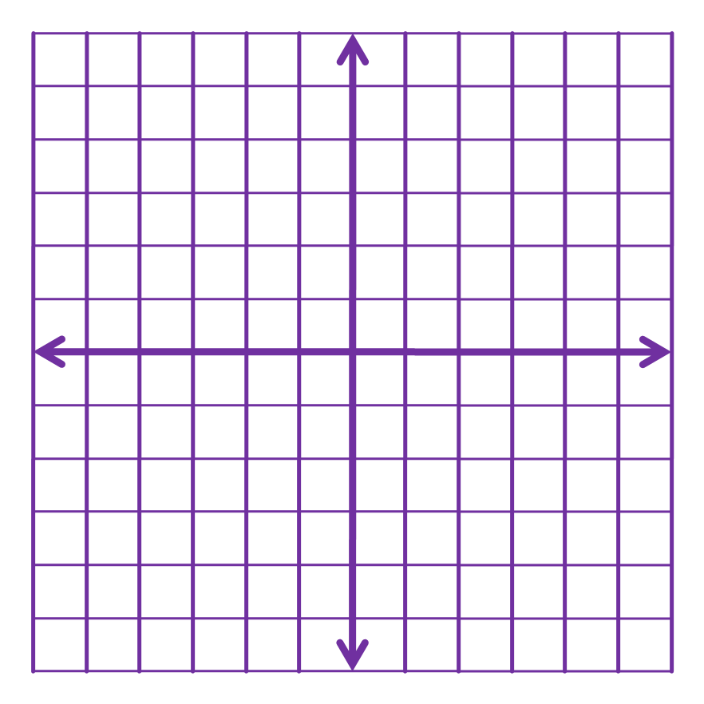
1-01 Solve Linear Systems of Equations and Inequalities by Graphing
Solve by graphing $\left\{\begin{aligned}3&x+2&y&=−&4 \\ &x+3&y&=&1\end{aligned}\right.$
Notes:
(−2, 1)
Consistent and independent

Slide 7
1-01 Solve Linear Systems of Equations and Inequalities by Graphing
Solve by graphing$\left\{\begin{aligned}3x−2y=10 \\ 3x−2y=2\end{aligned}\right.$
Notes:
No solution
inconsistent

Slide 8
1-01 Solve Linear Systems of Equations and Inequalities by Graphing
To solve systems of inequalities
Graph them all on one graph.
Solution is where all graphs overlap

Slide 9
1-01 Solve Linear Systems of Equations and Inequalities by Graphing
Solve the system of inequalities
$\left\{\begin{aligned}x≥2 \\ x+y<3\end{aligned}\right.$

Slide 10
1-01 Solve Linear Systems of Equations and Inequalities by Graphing
Solve the system of inequalities
$\left\{\begin{matrix}y<−\frac{4x}{5}−4 \\ y>−\frac{4x}{5}+2\end{matrix}\right.$

Slide 11
1-02 Solve Linear Systems Algebraically
Objectives:
Solve a system of equations by substitution.
Solve a system of equations by elimination.

Slide 12
1-02 Solve Linear Systems Algebraically
Graphing to solve systems of equations has some problems.
Can you guess some?
Inaccurate
Sometimes hard to graph

Slide 13
1-02 Solve Linear Systems Algebraically
Substitution
Solve one equation for one variable
Use that expression to replace that variable in the other equation
Solve the new equation
Substitute back into the first equation
Solve for the second variable

Slide 14
1-02 Solve Linear Systems Algebraically
y is the same thing as x + 2
$$y=x+2$$
$$2x+y=8$$
$$2x+ y =8$$
$$3x+2=8$$
$$3x=6$$
$$x=2$$
$$y=x+2$$
$$y=4$$
$$(2,4)$$
$$2$$
$$x+2$$

Slide 15
1-02 Solve Linear Systems Algebraically
$$\begin{aligned}3&x+2&y&=&8 \\ &x+4&y&=−&4\end{aligned}$$
$$x=−4y−4$$
$$3 x +2y=8$$
$$−12y−12+2y=8$$
$$−10y−12=8$$
$$−10y=20$$
$$y=−2$$
$$(−2)$$
$$x=−4 y −4$$
$$x=4$$
$$(4,−2)$$
x is by itself. Solve for it.
$$(−4y−4)$$

Slide 16
1-02 Solve Linear Systems Algebraically
Elimination
Line up the equations into columns
Multiply one or both equations by numbers so that one variable has the same coefficient, but opposite sign
Add the equations
Solve the resulting equation
Substitute the value into one original equation and solve

Slide 17
1-02 Solve Linear Systems Algebraically
$$\begin{aligned}2&x−3&y&=−14 \\ 3&x−&y&=−7\end{aligned}$$
$$2x−3y=−14$$
$$−9x+3y=21$$
$$−7x =7$$
$$x=−1$$
$$(−1)$$
$$2 x −3y=−14$$
$$−2−3y=−14$$
$$−3y=−12$$
$$y=4$$
$$(−1,4)$$
$$\left(−3\right)\left(3x−y\right)=−7(−3)$$

Slide 18
1-02 Solve Linear Systems Algebraically
$$\begin{aligned}&\left(2\right)\left(\&3\&x+1\&1\&y\right)&=4&\left(2\right) \\ &\left(3\right)\left(−\&2\&x−\&6\&y\right)&=0&\left(3\right)\end{aligned}$$
$$(2)$$
$$\begin{aligned}3&x+1&1&y&=4 \\ −2&x−&6&y&=0\end{aligned}$$
$$6x+22y=8$$
$$−6x−18y=0$$
$$4y=8$$
$y=2$
$$−2x−6 y =0$$
$$−2x−12=0$$
$$−2x=12$$
$$x=−6$$
$$(−6, 2)$$

Slide 19
1-02 Solve Linear Systems Algebraically
Number of Solutions
If both variables disappear after you substitute or combine and
You get a true statement like 2 = 2 → infinite solutions
You get a false statement like 2 = 5 → no solution

Slide 20
1-02 Solve Linear Systems Algebraically
Summary of Solving Techniques
When to graph?
To get general picture and estimate
When to use substitution?
When one of the coefficients is 1
When to use elimination?
When none of the coefficients is 1

Slide 21
1-03 Solve Linear Systems in Three Variables
Objectives:
Solve a three-variable linear system of equations by elimination.
Describe the line of intersection for many solution case of a three-variable linear system.

Slide 22
1-03 Solve Linear Systems in Three Variables
We have now worked with 2 variables and 2 dimensions, but sometimes there are more
Linear equation in 3 variables graphs a plane
dimensions.

Slide 23
1-03 Solve Linear Systems in Three Variables
Solution to system in 3 variables
Ordered triple (x, y, z)
Example: Is (2, −4, 1) a solution of
$\left\{\begin{aligned}&x+3&y&−&z&=−11 \\ 2&x+&y&+&z&=1 \\ 5&x−2&y&+3&z&=21\end{aligned}\right.$
Notes:
Plug it in.
$$x+3y−z=−11$$
$$2+3\left(−4\right)−1=−11$$
$$−11=−11\text{✔}$$
$$2x+y+z=1$$
$$2\left(2\right)+\left(−4\right)+1=1$$
$$1=1\text{✔}$$
$$5x−2y+3z=21$$
$$5\left(2\right)−2\left(−4\right)+3\left(1\right)=21$$
$$21=21\text{✔}$$
Yes

Slide 24
1-03 Solve Linear Systems in Three Variables
One Solution
Infinitely Many Solutions
No Solutions

Slide 25
1-03 Solve Linear Systems in Three Variables
Elimination Method
Like two variables, you just do it more than once.
Combine first and second to eliminate a variable
Combine second and third to eliminate the same variable as before
Combine these new equations to find the two variables
Substitute those two variables into one of the original equations to get the third variable
If you get a false statement like 8 = 0 → no solution
If you get an identity like 0 = 0 → infinitely many solutions

Slide 26
1-03 Solve Linear Systems in Three Variables
$$\left\{\begin{aligned}2x+3&y+7&z&=−&3 \\ x−6&y+&z&=−&4 \\ −x−3&y+8&z&=&1\end{aligned}\right.$$
Notes:
Combine first two equations (multiply second by -2):
2x+3y+7z=-3
-2x+12y-2z=8
15y + 5z = 5 → 3y + z = 1
Combine last two equation (just add):
x-6y+z=-4
-x-3y+8z=1
-9y + 9z = -3 → -3y + 3z = -1
Combine the combinations (just add):
3y + z = 1
-3y + 3z = -1
4z = 0 → z = 0
Substitute into 3y + z = 1:
3y + 0 = 1 → y = 1/3
Substitute into x – 6y + z = -4:
x – 6(1/3) + 0 = -4 → x – 2 = -4 → x = -2
(-2, 1/3, 0)

Slide 27
1-03 Solve Linear Systems in Three Variables
$$\left\{\begin{aligned}−x+2&y+&z&=&3 \\ 2x+2&y+&z&=&5 \\ 4x+4&y+2&z&=&6\end{aligned}\right.$$
Notes:
No Solution

Slide 28
1-03 Solve Linear Systems in Three Variables
$$\left\{\begin{aligned}x&+&y&+&z&=6 \\ x&−&y&+&z&=6 \\ 4x&+&y&+4&z&=24\end{aligned}\right.$$
Notes:
Combine first two equations (no multiplying necessary):
$$\begin{aligned}x+y+z=6 \\ x−y+z=6 \\ −−−−−−−− \\ 2x +2z=12\end{aligned}$$
$$x+z=6$$
Combine last two equation (just add):
$$\begin{aligned}x−y+z=6 \\ 4x+y+4z=24 \\ −−−−−−− \\ 5x +5z=30\end{aligned}$$
$$x+z=6$$
Combine the combinations (multiply 2nd by −1):
$$\begin{aligned}x+z= 6 \\ −x−y=−6 \\ −−−−−− \\ 0=0\end{aligned}$$
This is many solutions. Describe points of intersection
Let z = a
Use one of the reduced equations to find x.
$$x+z=6$$
$$x+a=6$$
$$x=6−a$$
Substitute into one of the original equations to find y.
$$x+y+z=6$$
$$\left(6−a\right)+y+a=6$$
$$y=0$$
Solution is (6 – a, 0, a)

Slide 29
1-03 Solve Linear Systems in Three Variables
If there are infinitely many solutions
Let z = a (Use x, y, or z based on what is convenient)
Solve for y in terms of a
Substitute those to find x in terms of a
Sample answer (2a, a + 4, a)

Slide 30
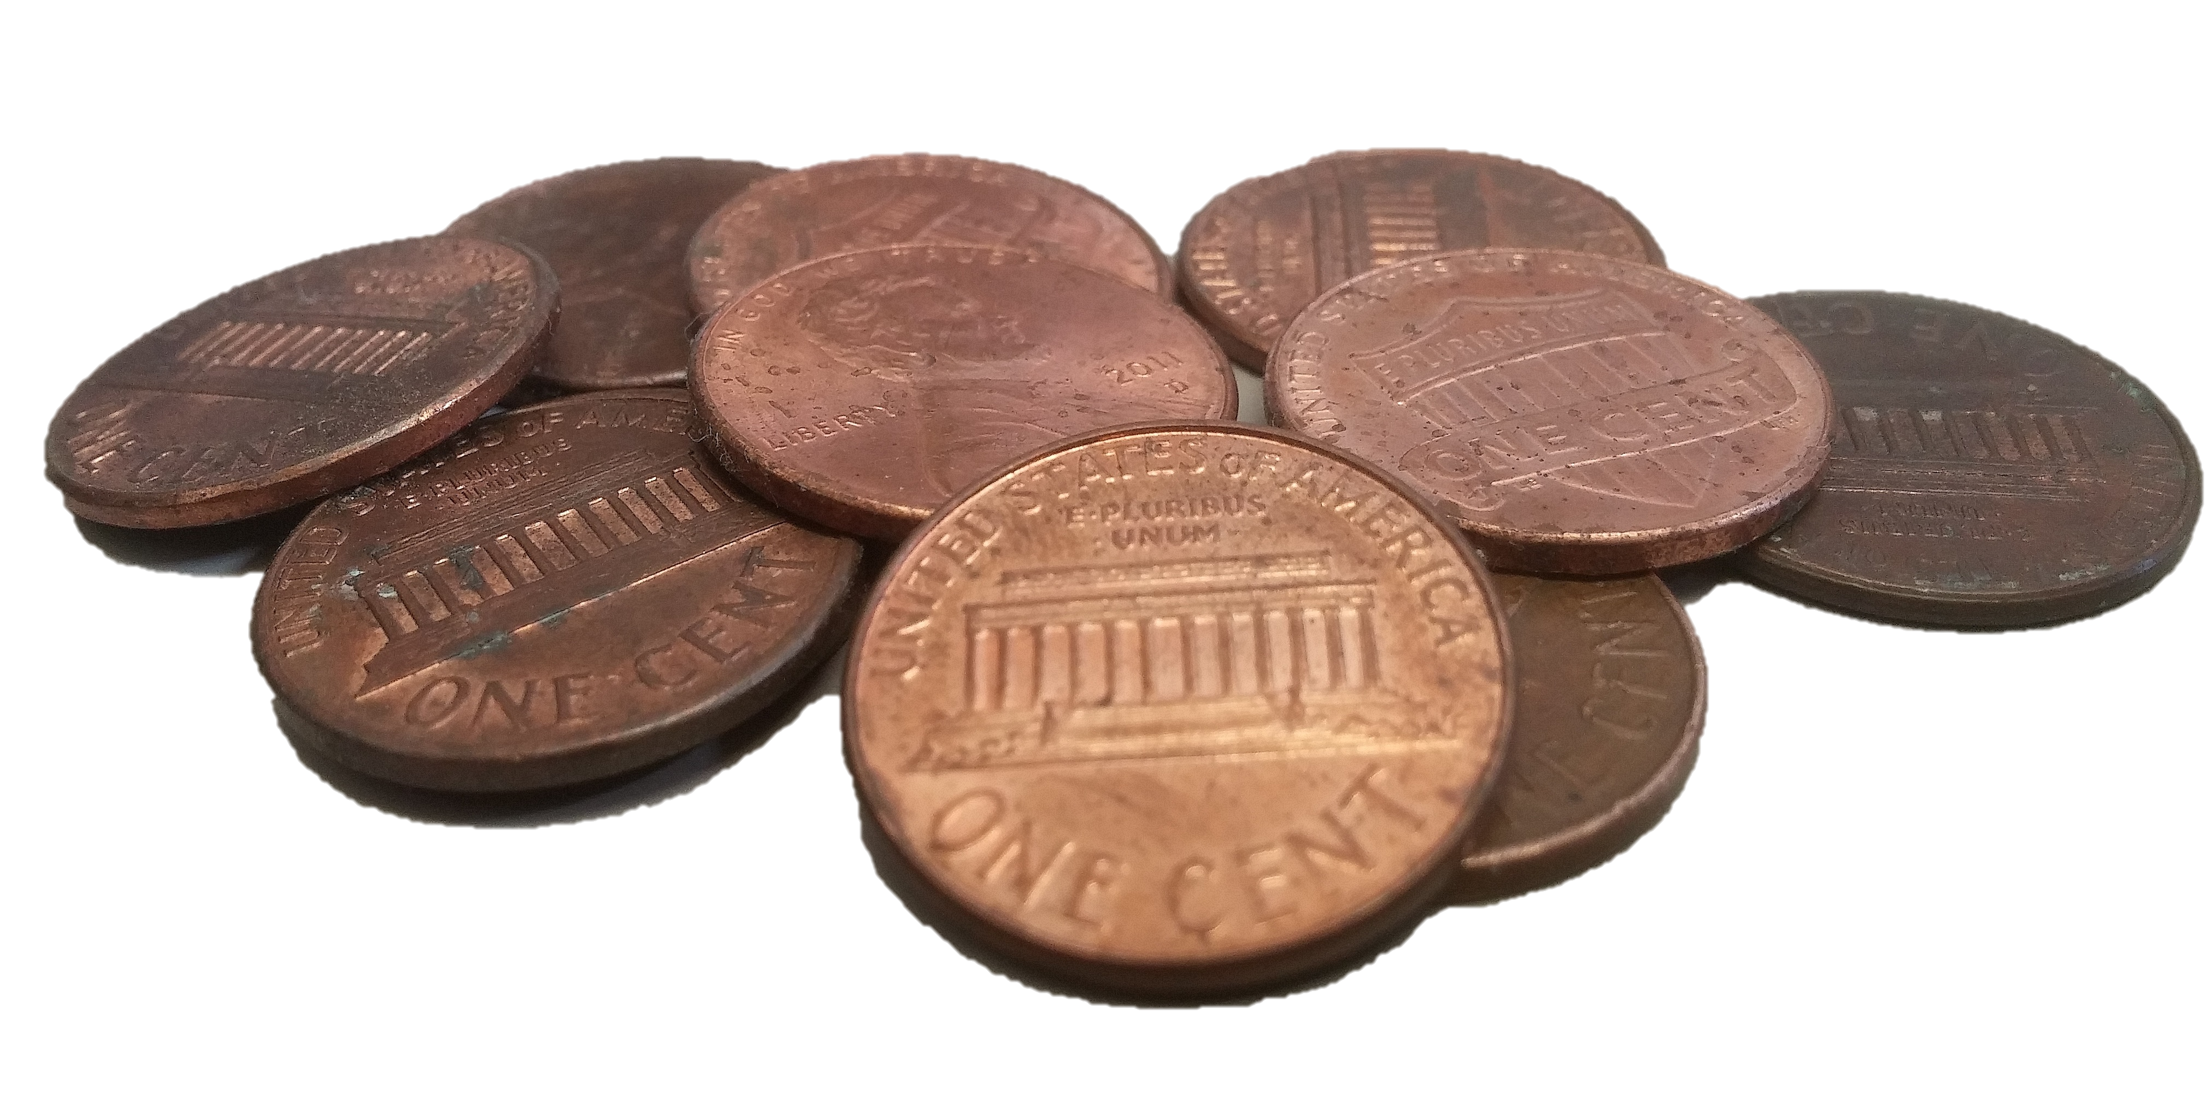
1-03 Solve Linear Systems in Three Variables
You have $1.42 in quarters, nickels, and pennies. You have twice as many nickels as quarters. You have 14 coins total. How many of each coin do you have?
Notes:
Translate each sentence into an equation
0.25q + 0.05n + 0.01p = 1.42
n = 2q
q + n + p = 14
This makes the system of equations.
$$\left\{\begin{aligned}0.25q&+&0.05n&+&0.01p&=&1.42 \\ 2q&−&n&&&=&0 \\ q&+&n&+&p&=&14\end{aligned}\right.$$
Start the elimination process. Because the second equation already is missing p, we can combine the first and third equations and eliminate p. Then we will have two equations with just q and n.
Multiply the first equation by −100.
$$\begin{aligned}−25q−5n−p=−142 \\ +q+n+p=14 \\ −24q−4n=−128\end{aligned}$$
Combine this with the second equation. Multiply the second equation by −4.
$$\begin{aligned}−8q+4n=0 \\ −24q−4n=−128 \\ −32q=−128\end{aligned}$$
$$q=4$$
Substitute this into the second equation to find n.
$$2q−n=0$$
$$2(4)−n=0$$
$$n=8$$
Substitute q = 4 and n = 8 into one of the original equations to find p.
$$q+n+p=14$$
$$4+8+p=14$$
$$p=2$$
Your little brother has 2 pennies, 8 nickels, and 4 quarters.

Slide 31
1-04 Perform Basic Matrix Operations (12.1)
Objectives:
Solve for variables in matrices given equal matrices.
Add and subtract matrices.
Multiply a scalar number with a matrix.

Slide 32
1-04 Perform Basic Matrix Operations (12.1)
Matrices are simply a way to organize data.
For example, a computer desktop wallpaper (bitmap) is a matrix. Each element tells what color pixel goes in that spot.

Slide 33
1-04 Perform Basic Matrix Operations (12.1)
A matrix is a rectangular arrangement of things (variables or numbers in math)
$\left[\begin{matrix}2 & −1 & 5 & a \\ 2 & y & 6 & b \\ 3 & 14 & x & c\end{matrix} \right]$
Dimensions
Rows by columns
3×4 for the above matrix

Slide 34
1-04 Perform Basic Matrix Operations (12.1)
In order for two matrices to be equal, they must be the same dimensions and corresponding elements must be the same
$\left[\begin{matrix}1 & 3 \\ 2 & 4\end{matrix}\right]=\left[\begin{matrix}1 & 3 \\ 2 & 4\end{matrix}\right]$
Find the variables $\left[\begin{matrix}2 & y+1 \\ x/3 & 4\end{matrix}\right]=\left[\begin{matrix}w & −4 \\ 5 & z−4\end{matrix}\right]$
Notes:
$$2=w,$$
$$\frac{x}{3}=5 → x=15,$$
$$y+1=−4 → y=−5,$$
$$4=z−4 → z=8$$

Slide 35
1-04 Perform Basic Matrix Operations (12.1)
Adding and Subtracting
You can only add and subtract matrices that are the same dimensions
When you add or subtract, add the corresponding elements.
$\left[\begin{matrix}1 & 2 \\ −5 & 4\end{matrix}\right]+\left[\begin{matrix}−2 & 5 \\ 4 & −3\end{matrix}\right]$
Notes:
$$\left[\begin{matrix}1+\left(−2\right) & 2+5 \\ −5+4 & 4+\left(−3\right)\end{matrix}\right]$$
$$\left[\begin{matrix}−1 & 7 \\ −1 & 1\end{matrix}\right]$$

Slide 36
1-04 Perform Basic Matrix Operations (12.1)
$\left[\begin{matrix}2 & −3\end{matrix}\right]−\left[\begin{matrix}3 & 4\end{matrix}\right]+[\begin{matrix}1 & 0\end{matrix}]$
$\left[\begin{matrix}1 & 4 \\ 2 & 3\end{matrix}\right]−\left[\begin{matrix}0 & 3 & 1 \\ 2 & 5 & 2\end{matrix}\right]$
Notes:
$$\left[\begin{matrix}2−3+1 & −3−4+0\end{matrix}\right]$$
$$\left[\begin{matrix}0 & −7\end{matrix}\right]$$
Can’t add because different dimensions

Slide 37
1-04 Perform Basic Matrix Operations (12.1)
Scalar Multiplication
Multiply each element by the scalar
Distribute
$3\left[\begin{matrix}5 & −2 & 7 \\ −3 & 8 & 4\end{matrix}\right]$
Notes:
$$\left[\begin{matrix}3·5 & 3·−2 & 3·7 \\ 3·−3 & 3·8 & 3·4\end{matrix}\right]$$
$$\left[\begin{matrix}15 & −6 & 21 \\ −9 & 24 & 12\end{matrix}\right]$$

Slide 38
1-04 Perform Basic Matrix Operations (12.1)
The National Weather Service keeps track of weather.
What is meaning of the first matrix + second matrix?
Use matrix operations to find the total weather stats of each city
June 2014 | Benton Harbor | South Bend
Precip Days | 13 | 18
Clear Days | 16 | 13
Ab Norm T | 12 | 19
July 2014 | Benton Harbor | South Bend
Precip Days | 14 | 15
Clear Days | 18 | 18
Ab Norm T | 2 | 8
Notes:
*Precip Days = Days with precipitation
Clear Days = Days with no clouds
Ab Norm T = Days with Above Normal Temperature
the total number of days of each type for each city
$$\left[\begin{matrix}13+14 & 18+15 \\ 16+18 & 13+18 \\ 12+2 & 19+8\end{matrix}\right]$$
$$\left[\begin{matrix}27 & 33 \\ 34 & 31 \\ 14 & 27\end{matrix}\right]$$

Slide 39
1-05 Multiply Matrices (12.2)
Objectives:
Multiply matrices.
Use matrix multiplication to solve real-life problems.
.

Slide 40
1-05 Multiply Matrices (12.2)
Yesterday we learned all about matrices and how to add and subtract them. But how do you multiply or divide matrices?
Today we will multiply matrices.
Later we will find out that you can’t divide by a matrix.

Slide 41
1-05 Multiply Matrices (12.2)
Matrix multiplication can only happen if the number of columns of the first matrix is the same as the number of rows on the second matrix.
You can multiply a 3×5 with a 5×2.
3×5 ⋅ 5×2 → 3×2 will be the dimensions of the answer
Because of this order does matter!

Slide 42
1-05 Multiply Matrices (12.2)
$$\left[\begin{matrix}1 & 2 \\ 0 & −3\end{matrix}\right]⋅\left[\begin{matrix}−2 & 1 \\ 4 & 3\end{matrix}\right]$$
$$1⋅−2$$
$$+2⋅4$$
$$1⋅1+2⋅3$$
$$0⋅−2+−3⋅4$$
$$0⋅1+−3⋅3$$
$$6$$
$$7$$
$$−12$$
$$−9$$

Slide 43
1-05 Multiply Matrices (12.2)
$$\left[\begin{matrix}1 & 0 & 4 \\ −2 & 3 & 2\end{matrix}\right]∙\left[\begin{matrix}−1 \\ 3 \\ 5\end{matrix}\right]$$
$$1∙−1+0∙3+4∙5$$
$$−2∙−1+3∙3+2∙5$$
$$19$$
$$21$$

Slide 44
1-05 Multiply Matrices (12.2)
Use the given matrices to evaluate 2(AC) + B
$A=\left[\begin{matrix}5 & −9 \\ −1 & 3\end{matrix}\right], B=\left[\begin{matrix}0 \\ 4\end{matrix}\right], C=\left[\begin{matrix}2 \\ −6\end{matrix}\right]$
Notes:
$$2\left(\left[\begin{matrix}5 & −9 \\ −1 & 3\end{matrix}\right]\left[\begin{matrix}2 \\ −6\end{matrix}\right]\right)+\left[\begin{matrix}0 \\ 4\end{matrix}\right]$$
$$2\left(\left[\begin{matrix}5·2+\left(−9\right)·\left(−6\right) \\ \left(−1\right)·2+3·\left(−6\right)\end{matrix}\right]\right)+\left[\begin{matrix}0 \\ 4\end{matrix}\right]$$
$$2\left[\begin{matrix}64 \\ −20\end{matrix}\right]+\left[\begin{matrix}0 \\ 4\end{matrix}\right]$$
$$\left[\begin{matrix}128 \\ −40\end{matrix}\right]+\left[\begin{matrix}0 \\ 4\end{matrix}\right]$$
$$\left[\begin{matrix}128 \\ −36\end{matrix}\right]$$

Slide 45
1-05 Multiply Matrices (12.2)
The members of two bowling leagues submit meal choices for an upcoming banquet as shown. Each pizza meal costs $16, each spaghetti meal costs $22, and each Sam’s chicken meal costs $18. Use matrix multiplication to find the total cost of the meals for each league.
 | Pizza | Spaghetti | Sam’s Chicken
League A | 18 | 35 | 7
League B | 6 | 40 | 9
Notes:
$$\left[\begin{matrix}18 & 35 & 7 \\ 6 & 40 & 9\end{matrix}\right]\left[\begin{matrix}16 \\ 22 \\ 18\end{matrix}\right]$$
$$\left[\begin{matrix}18·16+35·22+7·18 \\ 6·16+40·22+9·18\end{matrix}\right]$$
$$\left[\begin{matrix}1184 \\ 1138\end{matrix}\right]$$
League A: $1184, League B: $1138

Slide 46
1-06 Evaluate Determinants (12.3)
After this lesson…
• I can find the determinant of a square matrix.
• I can use determinants to find areas of triangles.
• I can use determinants to solve systems of equations.

Slide 47
1-06 Evaluate Determinants (12.3)
You had to know that all this matrix stuff must have some purpose.
Uses of matrices (that we will investigate today)
Solve systems of equations
Find the area of a triangle when we only know the coordinates of its vertices

Slide 48
1-06 Evaluate Determinants (12.3)
Determinant
Number associated with square matrices
Symbolized by det A or | A |
Vertical lines mean determinant
I won’t answer that question on the test for you!

Slide 49
1-06 Evaluate Determinants (12.3)
Determinant of 2×2 matrix
Multiply along the down diagonal and subtract the product of the up diagonal.
$\left|\begin{matrix}2 & −1 \\ 3 & 4\end{matrix}\right|$
Notes:
$$2\left(4\right)−3(−1)=8+3=11$$

Slide 50
1-06 Evaluate Determinants (12.3)
Determinant of 3×3 Matrix
Copy the first 2 columns behind the matrix and then add the products of the down diagonals and subtract the product of the up diagonals.
$\left|\begin{matrix}1 & 2 & 3 \\ 4 & 5 & 6 \\ 7 & 8 & 9\end{matrix}\right|$
$$\begin{matrix}1 & 2 \\ 4 & 5 \\ 7 & 8\end{matrix}$$
Notes:
$$159+267+348−753−861−942$$
$$=45+84+96−105−48−72$$
$$=225−225$$
$$=0$$

Slide 51
1-06 Evaluate Determinants (12.3)
Area of a Triangle
$$Area=±\frac{1}{2}\left|\begin{matrix}x_{1} & y_{1} & 1 \\ x_{2} & y_{2} & 1 \\ x_{3} & y_{3} & 1\end{matrix}\right|$$
where x’s and y’s are the coordinates of the vertices

Slide 52
1-06 Evaluate Determinants (12.3)
Find the area of a triangle with vertices of (2,4), (5,1), and (2,-2)
$Area=±\frac{1}{2}\left|\begin{matrix}2 & 4 & 1 \\ 5 & 1 & 1 \\ 2 & −2 & 1\end{matrix}\right|$
Notes:
$$±\frac{1}{2} \left(211+412+15\left(−2\right)−211−\left(−2\right)12−154\right)$$
$$±\frac{1}{2}\left(2+8+\left(−10\right)−2−\left(−4\right)−20\right)$$
$$±\frac{1}{2}\left(−18\right)$$
$$9$$
$$Area = 9$$

Slide 53
1-06 Evaluate Determinants (12.3)
Cramer’s Rule
Write the equations in standard form
Make a matrix out of the coefficients
2×2
$\begin{aligned}ax+by&=e \\ cx+dy&=f\end{aligned}$
$$x=\frac{\left|\begin{matrix}e & b \\ f & d\end{matrix}\right|}{\left|\begin{matrix}a & b \\ c & d\end{matrix}\right|},y=\frac{\left|\begin{matrix}a & e \\ c & f\end{matrix}\right|}{\left|\begin{matrix}a & b \\ c & d\end{matrix}\right|}$$
gives
Notes:
Notice that the numerator and denominator are the same except for the columns containing the coefficients of the variable you are solving for is replaced with the numbers from the constants column.

Slide 54
1-06 Evaluate Determinants (12.3)
$\begin{aligned}2x&+&y&=&1 \\ 3x&−2&y&=−2&3\end{aligned}$
Notes:
$$x=\frac{\left|\begin{matrix}1 & 1 \\ −23 & −2\end{matrix}\right|}{\left|\begin{matrix}2 & 1 \\ 3 & −2\end{matrix}\right|}=\frac{1\left(−2\right)−\left(−23\right)\left(1\right)}{2\left(−2\right)−3\left(1\right)}=\frac{21}{−7}=−3$$
$$y=\frac{\left|\begin{matrix}2 & 1 \\ 3 & −23\end{matrix}\right|}{\left|\begin{matrix}2 & 1 \\ 3 & −2\end{matrix}\right|}=\frac{2\left(−23\right)−3\left(1\right)}{−7}=\frac{−49}{−7}=7$$
(−3, 7)

Slide 55
1-06 Evaluate Determinants (12.3)
Cramer’s Rule on a 3×3 System
Same as 2×2 system
The denominator is the determinant of the coefficient matrix and the numerator is the same only with the column of the variable you are solving for replaced with the = column.

Slide 56
1-06 Evaluate Determinants (12.3)
${2x−y+6z=−4 \atop \begin{aligned}6x+4y−5z=−7 \\ −4x−2y+5z=9 \end{aligned}}$
Notes:
$$x=\frac{\left|\begin{matrix}−4 & −1 & 6 \\ −7 & 4 & −5 \\ 9 & −2 & 5\end{matrix}\right|}{\left|\begin{matrix}2 & −1 & 6 \\ 6 & 4 & −5 \\ −4 & −2 & 5\end{matrix}\right|} \frac{\begin{matrix}−4 & −1 \\ −7 & 4 \\ 9 & −2\end{matrix}}{\begin{matrix}2 & −1 \\ 6 & 4 \\ −4 & −2\end{matrix}}=\frac{\left(−4\right)\left(4\right)\left(5\right)+\left(−1\right)\left(−5\right)\left(9\right)+\left(6\right)\left(−7\right)\left(−2\right)−\left(9\right)\left(4\right)\left(6\right)−\left(−2\right)\left(−5\right)\left(−4\right)−\left(5\right)\left(−7\right)\left(−1\right)}{\left(2\right)\left(4\right)\left(5\right)+\left(−1\right)\left(−5\right)\left(−4\right)+\left(6\right)\left(6\right)\left(−2\right)−\left(−4\right)\left(4\right)\left(6\right)−\left(−2\right)\left(−5\right)\left(2\right)−\left(5\right)\left(6\right)\left(−1\right)}=\frac{−162}{54}=−3$$
$$y=\frac{\left|\begin{matrix}2 & −4 & 6 \\ 6 & −7 & −5 \\ −4 & 9 & 5\end{matrix}\right|}{\left|\begin{matrix}2 & −1 & 6 \\ 6 & 4 & −5 \\ −4 & −2 & 5\end{matrix}\right|} \frac{\begin{matrix}2 & −4 \\ 6 & −7 \\ −4 & 9\end{matrix}}{\begin{matrix}2 & −1 \\ 6 & 4 \\ −4 & −2\end{matrix}}=\frac{\left(2\right)\left(−7\right)\left(5\right)+\left(−4\right)\left(−5\right)\left(−4\right)+\left(6\right)\left(6\right)\left(9\right)−\left(−4\right)\left(−7\right)\left(6\right)−\left(9\right)\left(−5\right)\left(2\right)−\left(5\right)\left(6\right)\left(−4\right)}{54}=\frac{216}{54}=4$$
$$z=\frac{\left|\begin{matrix}2 & −1 & −4 \\ 6 & 4 & −7 \\ −4 & −2 & 9\end{matrix}\right|}{\left|\begin{matrix}2 & −1 & 6 \\ 6 & 4 & −5 \\ −4 & −2 & 5\end{matrix}\right|} \frac{\begin{matrix}2 & −1 \\ 6 & 4 \\ −4 & −2\end{matrix}}{\begin{matrix}2 & −1 \\ 6 & 4 \\ −4 & −2\end{matrix}}=\frac{\left(2\right)\left(4\right)\left(9\right)+\left(−1\right)\left(−7\right)\left(−4\right)+\left(−4\right)\left(6\right)\left(−2\right)−\left(−4\right)\left(4\right)\left(−4\right)−\left(−2\right)\left(−7\right)\left(2\right)−\left(9\right)\left(6\right)\left(−1\right)}{54}=\frac{54}{54}=1$$
(−3, 4, 1)

Slide 57
1-07 Use Inverse Matrices to Solve Linear Systems (12.4)
After this lesson…
• I can find the inverse of a matrix.
• I can solve linear systems using inverse matrices.
• I can solve real-life problems using inverse matrices.

Slide 58
1-07 Use Inverse Matrices to Solve Linear Systems (12.4)
You can use matrices to solve linear systems in ways different from Cramer’s Rule.
We will learn how, but it requires that we know how to find inverse matrices.

Slide 59
1-07 Use Inverse Matrices to Solve Linear Systems (12.4)
The Identity Matrix multiplied with any matrix of the same dimension equals the original matrix.
A ∙ I = I ∙ A = A
This is the matrix equivalent of 1
$$\left[\begin{matrix}1 & 0 \\ 0 & 1\end{matrix}\right]$$
$$\left[\begin{matrix}1 & 0 & 0 \\ 0 & 1 & 0 \\ 0 & 0 & 1\end{matrix}\right]$$
Notes:
1’s on diagonal, everything else is zero

Slide 60
1-07 Use Inverse Matrices to Solve Linear Systems (12.4)
You cannot divide by a matrix!
So we multiply by the inverse of a matrix.
A·A⁻¹ = [1] = I
Just like $x \left(x^{−1}\right)$= $x\left(\frac{1}{x}\right)$ = 1
If A, B, and X are matrices, and
A·X = B
A⁻¹·A·X = A⁻¹·B
I·X = A⁻¹·B
X = A⁻¹·B

Slide 61
1-07 Use Inverse Matrices to Solve Linear Systems (12.4)
The Rule for 2×2 (Memorize)
If $A=\left[\begin{matrix}a & b \\ c & d\end{matrix}\right]$
$A^{−1}=\frac{1}{\left|\begin{matrix}a & b \\ c & d\end{matrix}\right|}\left[\begin{matrix}d & −b \\ −c & a\end{matrix}\right]$

Slide 62
1-07 Use Inverse Matrices to Solve Linear Systems (12.4)
$${\left[\begin{matrix}1 & 2 \\ 3 & 4\end{matrix}\right]}^{−1}$$
$$=\frac{1}{\left|\begin{matrix}1 & 2 \\ 3 & 4\end{matrix}\right|}\left[\begin{matrix}4 & −2 \\ −3 & 1\end{matrix}\right]$$
$$=\frac{1}{1\left(4\right)−3(2)}\left[\begin{matrix}4 & −2 \\ −3 & 1\end{matrix}\right]$$
$$\left[\begin{matrix}−2 & 1 \\ \frac{3}{2} & −\frac{1}{2}\end{matrix}\right]$$
$$=\frac{1}{−2}\left[\begin{matrix}4 & −2 \\ −3 & 1\end{matrix}\right]$$

Slide 63
1-07 Use Inverse Matrices to Solve Linear Systems (12.4)
$${\left[\begin{matrix}−2 & −1 \\ 4 & 0\end{matrix}\right]}^{−1}$$
$$=\frac{1}{\left|\begin{matrix}−2 & −1 \\ 4 & 0\end{matrix}\right|}\left[\begin{matrix}0 & 1 \\ −4 & −2\end{matrix}\right]$$
$$=\frac{1}{−2\left(0\right)−4(−1)}\left[\begin{matrix}0 & 1 \\ −4 & −2\end{matrix}\right]$$
$$\left[\begin{matrix}0 & \frac{1}{4} \\ −1 & −\frac{1}{2}\end{matrix}\right]$$
$$=\frac{1}{4}\left[\begin{matrix}0 & 1 \\ −4 & −2\end{matrix}\right]$$

Slide 64
1-07 Use Inverse Matrices to Solve Linear Systems (12.4)
Check by multiplying the two matrices
$$\left[\begin{matrix}−2 & −1 \\ 4 & 0\end{matrix}\right]⋅\left[\begin{matrix}0 & \frac{1}{4} \\ −1 & −\frac{1}{2}\end{matrix}\right]$$
Notes:
$$\left[\begin{matrix}1 & 0 \\ 0 & 1\end{matrix}\right]$$

Slide 65
1-07 Use Inverse Matrices to Solve Linear Systems (12.4)
Solve a matrix equation
AX = B
$\left[\begin{matrix}−3 & 4 \\ 5 & −7\end{matrix}\right]X=\left[\begin{matrix}3 & 8 \\ 2 & −2\end{matrix}\right]$
Find A⁻¹
Notes:
$${\left[\begin{matrix}−3 & 4 \\ 5 & −7\end{matrix}\right]}^{−1}=\frac{1}{−3\left(−7\right)−5\left(4\right)}\left[\begin{matrix}−7 & −4 \\ −5 & −3\end{matrix}\right]$$
$=\frac{1}{1}\left[\begin{matrix}−7 & −4 \\ −5 & −3\end{matrix}\right]$
$$A^{−1}=\left[\begin{matrix}−7 & −4 \\ −5 & −3\end{matrix}\right]$$

Slide 66
1-07 Use Inverse Matrices to Solve Linear Systems (12.4)
A⁻¹AX = A⁻¹B
$$\left[\begin{matrix}−7 & −4 \\ −5 & −3\end{matrix}\right]\left[\begin{matrix}−3 & 4 \\ 5 & −7\end{matrix}\right]X=\left[\begin{matrix}−7 & −4 \\ −5 & −3\end{matrix}\right]\left[\begin{matrix}3 & 8 \\ 2 & −2\end{matrix}\right]$$
$$I⋅X=$$
$$−7\left(3\right)+−4(2)$$
$$−7\left(8\right)+−4(−2)$$
$$−5\left(3\right)+−3(2)$$
$$−5\left(8\right)+−3(−2)$$
$$X=\left[\begin{matrix}−29 & −48 \\ −21 & −34\end{matrix}\right]$$

Slide 67
1-07 Use Inverse Matrices to Solve Linear Systems (12.4)
Solve a system of linear equations
$\begin{aligned}2&x+&y&=−&1&3 \\ &x−3&y&=&1&1\end{aligned}$
Take your equation and write it as matrices
$\left[\begin{matrix}2 & 1 \\ 1 & −3\end{matrix}\right]\left[\begin{matrix}x \\ y\end{matrix}\right]=\left[\begin{matrix}−13 \\ 11\end{matrix}\right]$
Find the coefficient matrix inverse
Notes:
$${\left[\begin{matrix}2 & 1 \\ 1 & −3\end{matrix}\right]}^{−1}=\frac{1}{−7}\left[\begin{matrix}−3 & −1 \\ −1 & 2\end{matrix}\right]$$

Slide 68
1-07 Use Inverse Matrices to Solve Linear Systems (12.4)
Multiply the front of both sides by the inverse
Left side becomes $\left[\begin{matrix}x \\ y\end{matrix}\right]$
$\left[\begin{matrix}x \\ y\end{matrix}\right]=$
Notes:
$$\frac{1}{−7}\left[\begin{matrix}−3 & −1 \\ −1 & 2\end{matrix}\right]\left[\begin{matrix}−13 \\ 11\end{matrix}\right]$$
$=\frac{1}{−7}\left[\begin{matrix}39+−11 \\ 13+22\end{matrix}\right]$
$=\frac{1}{−7}\left[\begin{matrix}28 \\ 35\end{matrix}\right]$
$=\left[\begin{matrix}−4 \\ −5\end{matrix}\right]$
(-4, -5)

